Slide 1

North Korean Missile testing data analysis (1984 – 2023)
YJ Kim (DAI #5)

Slide 2
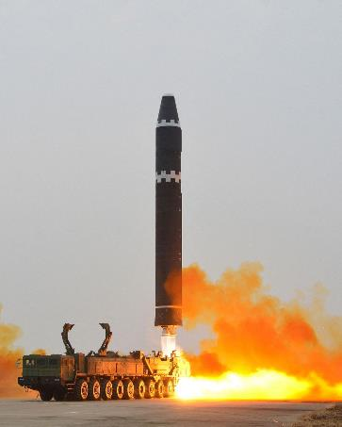
Decision maker’s Interest
Current DPRK missile testing capacities and capabilities
Historical progression of DPRK missile testing
Shifts in missile activities under different regimes
Analyzing DPRK military & political tactics
Ultimate Objective
Strategic defense decision making process
Source:
https://www.reuters.com/world/asia-pacific/north-korea-fires-ballistic-missile-south-korea-military

Slide 3
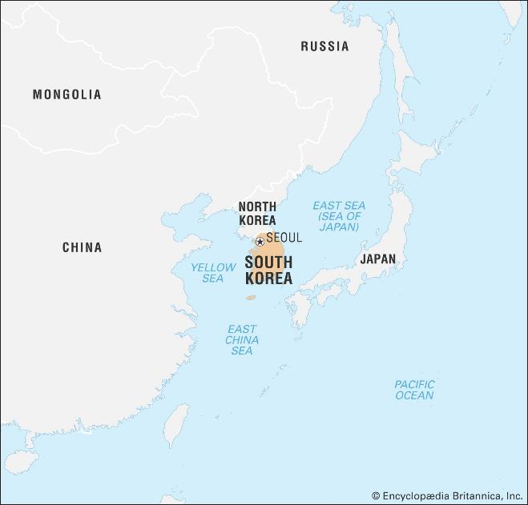
Agenda
Overview of DPRK Missile Facility Locations
Number of missile tests by timeline
Number of successes and failures by facility names
DPRK missile traveled distance expansions by timeline
DPRK Missile Landing Location groups
Source: https://www.britannica.com/place/South-Korea

Slide 4
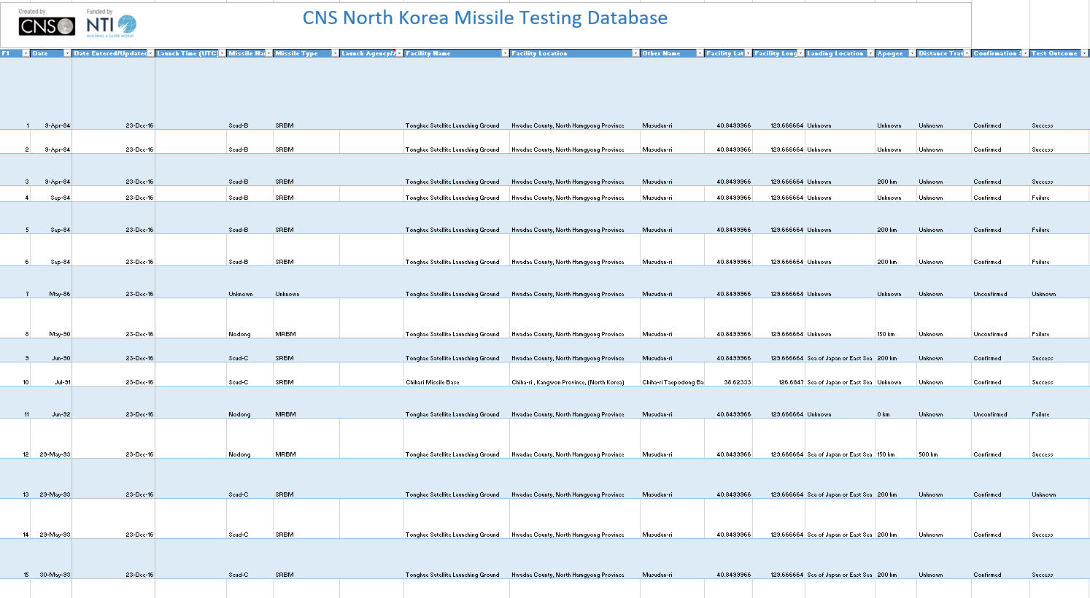
Data of interest
Facility names
Facility locations (Lat/Lon)
Dates
Distance
Landing locations
Test outcomes
(245 rows × 20 columns)

